Slide 1


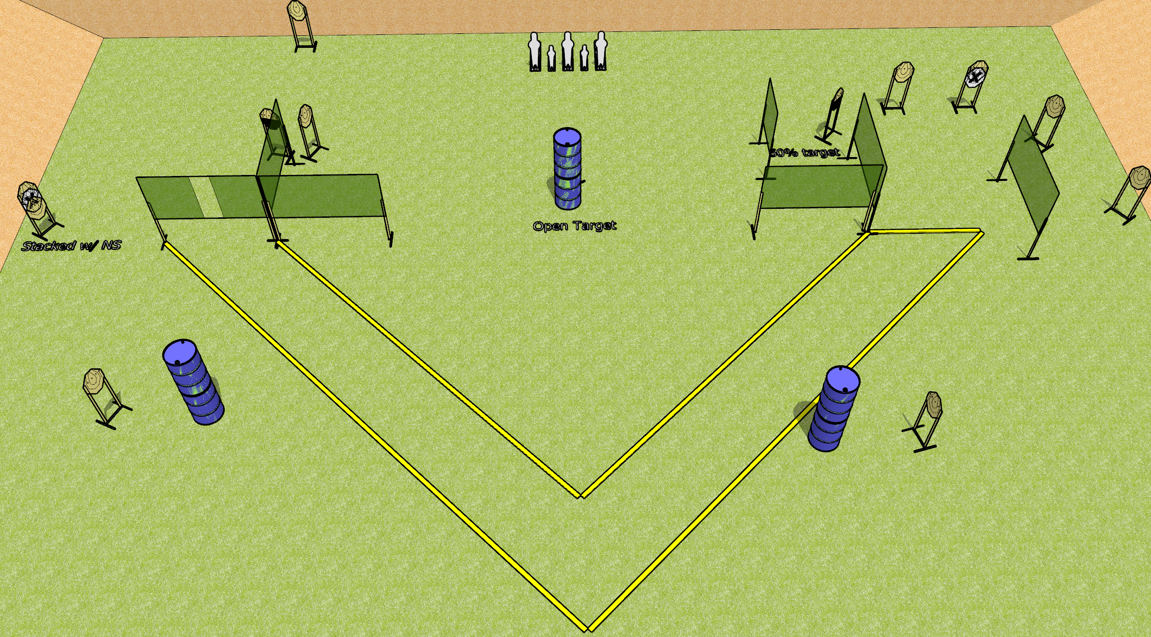
 | Dothan Gun Club – USPSA Match Very V Shaped Course Designer : Drew Coleman
Round Count 31 rounds 13 ISPC 3 Colt poppers, 2 mini poppers
Equipment List USE COLT POPPERS 12 wall feet, but the 4’ wall may not be needed 2 50% targets Use 8 foot fault line on the right, 3 10’ to form short legs of the V

Slide 2
Very V Shaped
Written Stage Briefing
Very V Shaped is a 31 round, 155 point, Comstock course of fire. There are 13 IPSC targets, 3 Colt poppers, and 2 mini poppers. The best 2 hits on paper will score, and steel must fall to score. The start signal is audible.
Handgun start position is anywhere inside the shooting area, wrists below belt. Handgun is loaded and holstered.
PCC start position is anywhere inside the shooting area. Loaded carbine is held with both hands, stock on belt, safety on.
On start signal, engage targets as they become available from within the shooting area.

